Slide 1
Digital innovation for better research : Open science & open data in the UK and beyond
Chris Keene

Slide 2
Jisc
Jisc is the UK higher, further education and skills sectors’ not-for-profit organisation for digital services and solutions
Provide trusted advice and practical assistance for universities, colleges and learning providers
Operate shared digital infrastructure and services
We…
Negotiate sector-wide deals with IT vendors and commercial publishers

Slide 3
What will be covered today
Background: The research landscape in the UK
Open Access in the UK/Europe
Open Data in the UK/Europe
Services and projects to support these
Open Science
Disruptive Innovation

Slide 5
Background : The Research environment in the UK
Research Funding is in two (dual) streams:
Funding Councils (one for each nation) such as HEFCE provide block grant
Research Councils (RCUK) provide project funding.
REF critical for research block grant.
The policies set by funders have played a key role in the update take in ‘open’
Notes:
To help set the context for this talk, I will set out briefly the research environment in the UK (research policy is mostly ‘UK’ wide though some things will be specific to England).
The number of Universities in the UK varies depending how you count them. The guardian league table lists 119. These are autonomous organisations, not part of government, but directed by government policy
Research Funding is in two (dual) streams:
Funding Councils (one for each nation) such as HEFCE provide block grant
Research Councils (RCUK) provide project funding.

Slide 6
Open Access in the UK
Notes:
How is it different to the rise internationally in OA

Slide 7
Open Access in the UK
The rise of OA was an international phenomenon - with the Budapest initiative (declaration) being the recognised kick-off date 2002
How did the UK differ: centralised support, community and innovation; and choice of platforms.
Institutional Repositories set up by nearly all Universities by 2009. Mostly using Eprints, and Dspace. The broad range of Universities (research, teaching), with different levels of resources meant they had differing levels of support
Jisc provided strong support for Institutional Repositories:
Sherpa Romeo / OpenDoar
Repository Support Network
Like many countries, while many researchers were engaged with OA and the IR, many were not. Take up and deposit of OA was not always great.

Slide 8
The rise of the Open Access Mandate : policy driving up OA deposit

Slide 9
Mandates
Finch Report In June 2012 the Finch Report was published. From the HEFCE website
The 'Finch' report - Dame Janet Finch chaired an independent working group on open access. The group's report, published in June 2012, supported the case for open access publishing through a balanced programme of action.
The report recognised the need for different channels to communicate research results, but recommended support for the 'gold' route in particular.

Slide 10
Research Councils (RCUK)
The RCUK policy[4] mandated that all peer-reviewed research papers funded by the Research Councils should be published in a OA-compliant journal, with requirements around length of embargo for Green OA and a CC-BY licence for Gold OA. This would apply to any outputs submitted after April 2013.
To support this, RCUK provided funds to a number of Universities (those which receive a certain level of RCUK funding) to pay for the Gold publication.

Slide 11
REF 2021 policy
All research articles /conference papers submitted for the REF should be deposited in a Open Access Repository and made publicly available.
Time limits on time to deposit, and embargos.
Some exceptions

Slide 12
Green or Gold : The UK and the EU

Slide 13
Green or gold in the UK
UK : The two main funders both allow Green and Gold Open Access, though has different emphasis. Other funders also push towards either Green or Gold, creating a mixed environment.
Research councils: broadly gold, HEFCE research grant/REF: broadly green
Others: Wellcome trust, research charities etc

Slide 14
Jisc Collections offsetting deal
The Springer Compact agreement was launched in January 2016, following a pilot phase between October and December 2015 when 368 articles were made available on open access free of charge. The Springer Compact agreement is a flipped model which enables researchers from 91 participating UK institutions to publish their articles immediately as open access in ~1,600 Springer journals as well as to access all content published in ~2,500 Springer journals.
In this flipped model, rather than paying a subscription fee and an unknown number of APC charges, the institution pays a set fee for unlimited APCs based on their 2014 APC expenditure with Springer and a top up fee to cover access to all the subscription content – thus containing the total cost of ownership.
Source https://scholarlycommunications.jiscinvolve.org/wp/2016/10/24/offsetting-models-update-on-the-springer-compact-deal/

Slide 15
Green and Gold : EU
In a recent report entitled "Access to and Preservation of Scientific Information in Europe" from the European Commission, a overview was published of the open access policies pursued by the various European countries. Notably, the Member States are divided as to whether the approach route to open access should be green or gold. The following countries prefer the green route: Belgium, Cyprus, Denmark, Estonia, Greece, Ireland, Lithuania, Malta, Norway, Portugal, Slovakia and Spain. While these countries are in favour of the gold route: Hungary, the Netherlands, Romania, Sweden and the United Kingdom. Germany, France, Croatia, Italy, Luxembourg, Poland and Finland support both.
https://www.unige.ch/biblio/openaccess/fr/accueil/actualites/europe-divided-over-green-and-gold-routes/

Slide 16
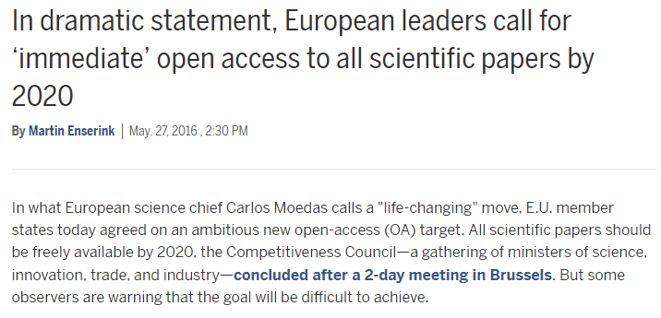
EU
Max Planck Proposal to Flip Subscriptions to OA http://www.arl.org/storage/documents/publications/MaxPlanckBrief-March2016-1.pdf

Slide 17
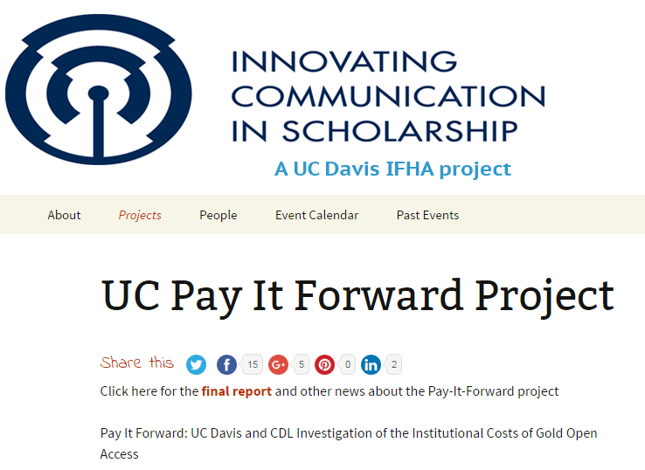
Mellon: Pay it forward report
Is Open Access sustainable : who pays?
Notes:
University of California / Mellon Pay it forward project : MacKenzie Smith
Who pays for international infrastructure??

Slide 18
Open Data
Notes:
The rise of ‘Open Data’ has gone alongside the rise of research data management. Ie. Data needs to be considered, managed, and access to it and re-use (or restrictions where required.) are part of this.
While it has been around for a number of years it is has seen strong focus and uptake in the last few years due to gov policy and mandates...

Slide 19
Open Data UK Policy : driving adoption
The rise of ‘Open Data’ has gone alongside the rise of research data management. Ie. Data needs to be considered, managed, and access to it and re-use (or restrictions where required.) are part of this.
While it has been around for a number of years it is has seen strong focus and uptake in the last few years due to gov policy and mandates...
Policy:
UK Open Research Data Forum:
“The initiative to create the Forum derived from the Royal Society’s 2012 report Science as an Open Enterprise and the UK Government (Research Sector Transparency Board) and international moves (e.g. G8 – June 2013) to promote an open data regime.”

Slide 20
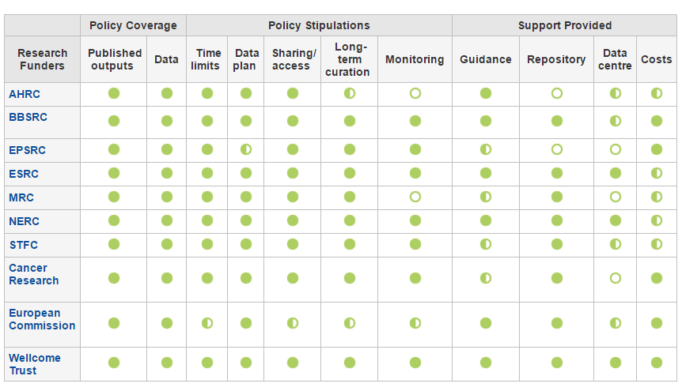
Policy leads to mandates
Notes:
Epsrc (engineering physical sciences research council) notable in requiring institutional deposit; requiring each institution to both have systems, but also workflows/support in place.

Slide 21
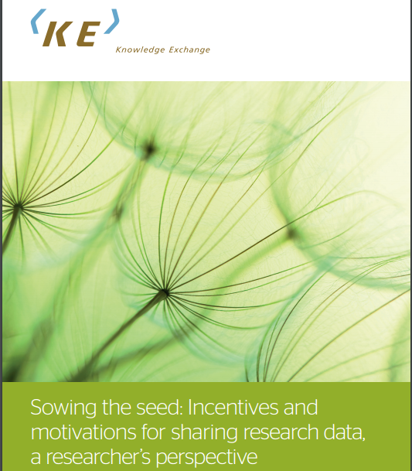
Knowledge Exchange
& CNRS!
Use cases
Notes:
http://repository.jisc.ac.uk/5662/1/KE_report-incentives-for-sharing-researchdata.pdf

Slide 22
Projects and Services to support digital disruptive innovation

Slide 23
Jisc OA services through an article lifecycle
Submission
Acceptance
Publication
Use
Select Journal
Check compliance
Manage costs
Deposit in repository
Report on compliance
Maximise impact
Record impact
Research publication lifecycle
Report
SHERPA RoMEO
SHERPA Fact
Monitor UK ^{R&D:Alpha}
Publications Router ^{R&D:Alpha}
Monitor local ^{R&D:Alpha}
IRUS-UK
Jisc services
SHERPA JULIET
SHERPA REF ^{R&D:Beta}
Jisc collections
OpenDOAR
CORE
RIOXX
Guidance, consultancy, technical support, and OA good practice

Slide 24
Notes:
Intending to get new version of this

Slide 25
(Jisc) UK research data services – in development
Function | Services / projects
Policies | For funders - Sherpa Juliet For publishers - Journal data policy registry?
Planning | For researchers - Data Management Plans: DMP-Online For managers - Data Asset Framework
Storage | Research Data Shared Service Framework agreements with cloud storage providers
Preservation | Research Data Shared Service Framework agreement with Arkivum
Reporting | Research Data Shared Service
Discovery | Research Data Discovery Service
Usage | IRUS4data
Citation | (DataCite)
Community: Research Data Network, advice and guidance, innovation programmes…
Technology: network, cyber-security,
access and identity, metadata…

Slide 26
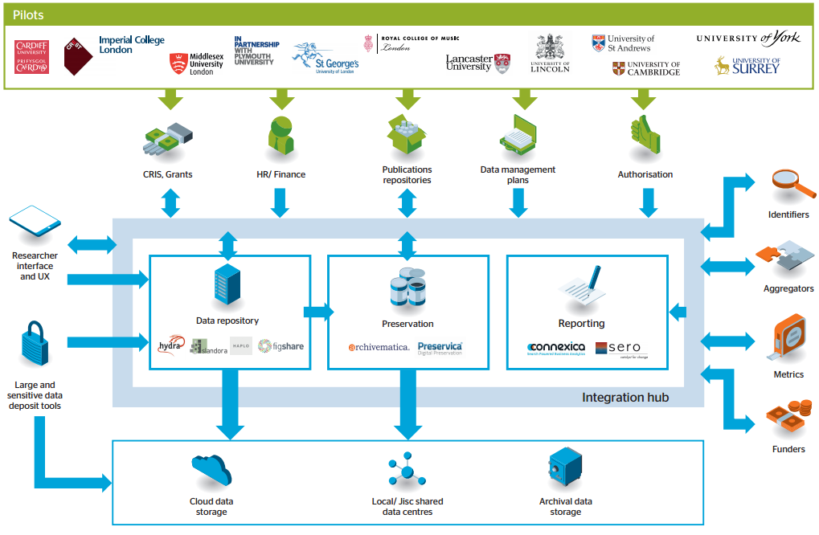
Research Data Shared Service Overview
Notes:
https://www.jisc.ac.uk/rd/projects/research-data-shared-service

Slide 27
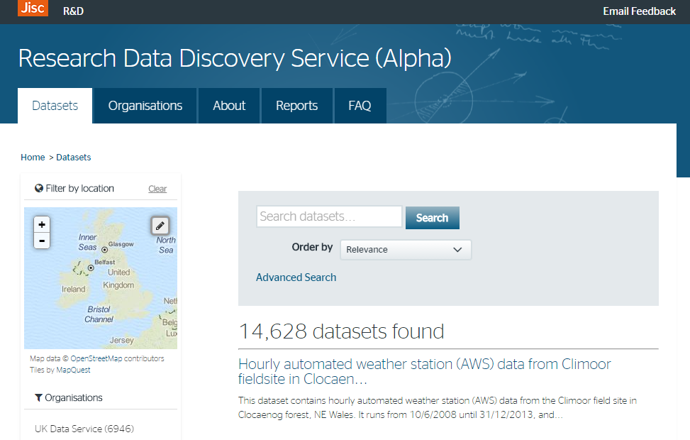
Research data discovery UK
A search tool to help researchers find research data across all UK repositories and data portals. This will encourage reuse of research data, particularly in interdisciplinary research as well as making data citation easier.
The alpha version of the service is available now, with >14k datasets aggregated.
http://ckan.data.alpha.jisc.ac.uk/dataset
Contact: Chris Brown
HE

Slide 28
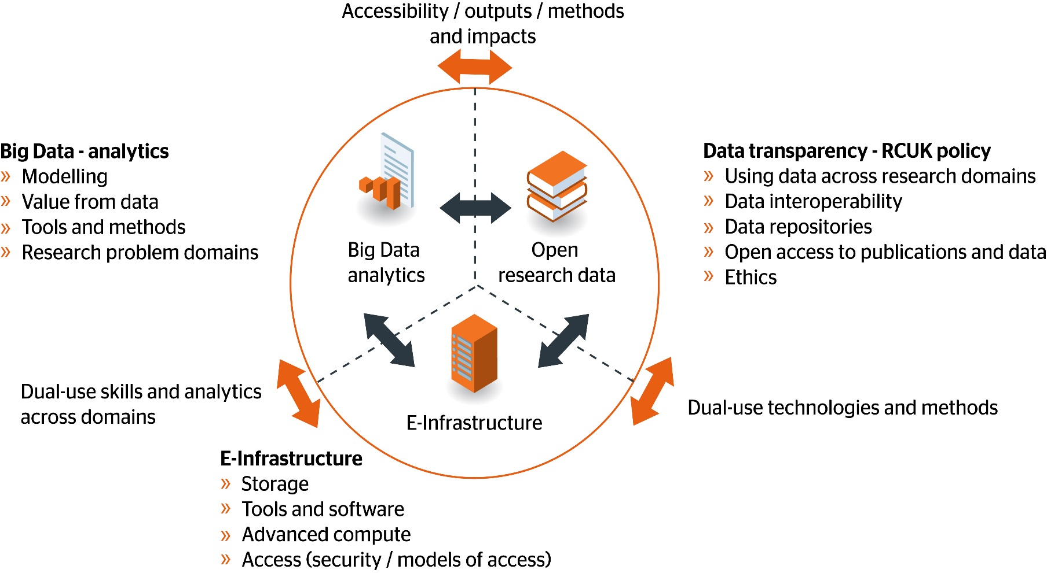
RCUK, Data for Discovery
RCUK diagram

Slide 29
Open Science
Notes:
Could be Open Research, includes all disciplines and subjects!

Slide 30
Open science
Notes:
Tim Gowers Polymath project can be seen as one of the early open science projects
Professor Jeremy G Frey http://www.southampton.ac.uk/chemistry/about/staff/jgf.page

Slide 31
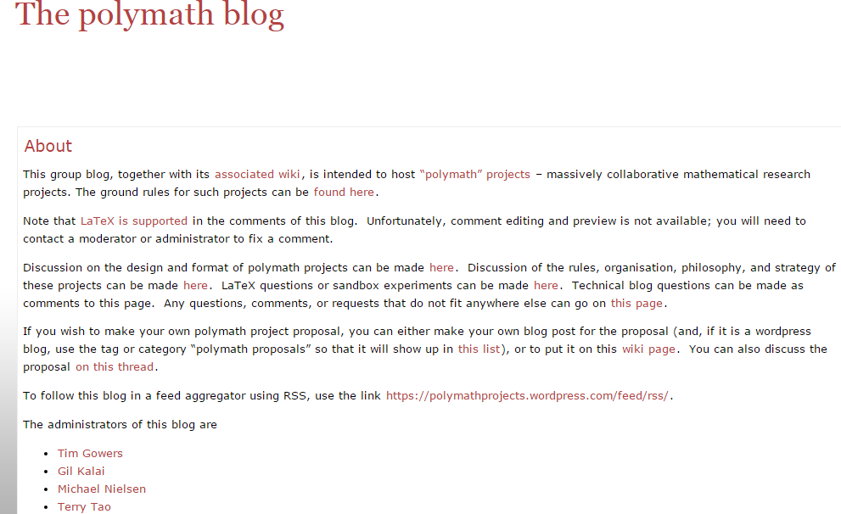
Tim Gower’s Polymath project

Slide 32
FAIR
FAIR Guiding Principles for Scientific Data Management and Stewardship
Findable |  | Accessible |  | Interoperable |  | Reusable
1 | (meta)data are assigned a globally unique and persistent identifier | 1 | (meta)data are retrievable by their identifier using a standardized communications protocol | 1 | (meta)data use a formal, accessible, shared, and broadly applicable language for knowledge representation | 1 | meta(data) are richly described with a plurality of accurate and relevant attributes
2 | data are described with rich metadata (defined by R1 below) | 1.1 | the protocol is open, free, and universally implementable | 2 | (meta)data use vocabularies that follow FAIR principles | 1.1 | (meta)data are released with a clear and accessible data usage license
3 | metadata clearly and explicitly include the identifier of the data it describes | 1.2 | the protocol allows for an authentication and authorization procedure, where necessary | 3 | (meta)data include qualified references to other (meta)data | 1.2 | (meta)data are associated with detailed provenance
4 | (meta)data are registered or indexed in a searchable Resource | 2 | metadata are accessible, even when the data are no longer available | 4 | (meta)data can be exchanged through a standard format | 1.3 | (meta)data meet domain-relevant community standards
Wilkinson, M.D. et al. (2016), The FAIR Guiding Principles for scientific data management and stewardship, Scientific Data 3, 15 March 2016, doi:10.1038/sdata.2016.18, retrieved online on 21 June 2016 from http://www.nature.com/articles/sdata201618

Slide 33
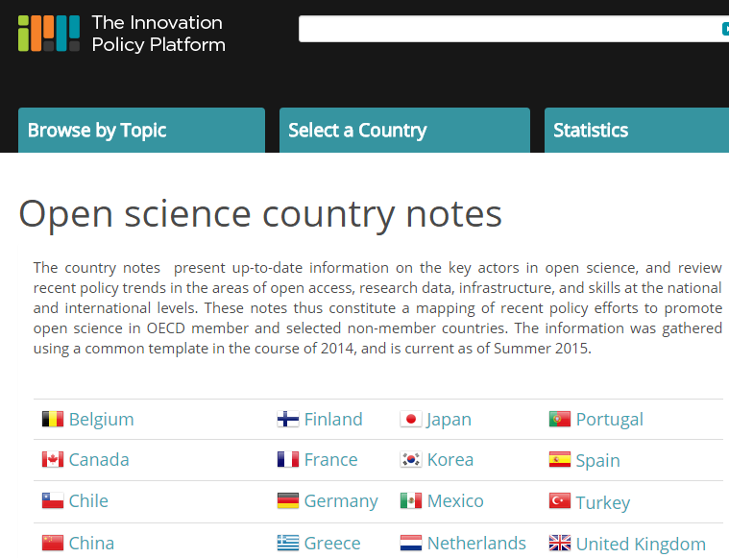
Innovative Policy Platform : OECD
https://www.innovationpolicyplatform.org/content/open-science-country-notes

Slide 34
EU projects to support Open Science

Slide 35
A federated globally accessible environment where researchers, innovators, companies and citizens can publish, find and re-use each other´s data and tools for research, innovation and educational purposes.
Imagine that this all operates under well defined and trusted conditions, supported by a sustainable and just value for money model.
This is the environment that must be fostered in Europe and beyond to ensure that European research and innovation is able to contribute fully to knowledge creation, meet global challenges and fuel economic prosperity in Europe.
This we believe encapsulates the concept of the European Open Science Cloud (EOSC), and indeed such a federated European endeavour might be expressed as the European contribution to a global research data commons
European Open Science Cloud
.
Notes:
Key high level framework/vision to enable open science internationally
The 'European Open Science Cloud' aims to create a trusted environment for hosting and processing research data to support EU science in its global leading role.
EOSC - a common set of light-touch standards that national governments and systems can adhere to enable interoperable data-intensive science across Europe.

Slide 36
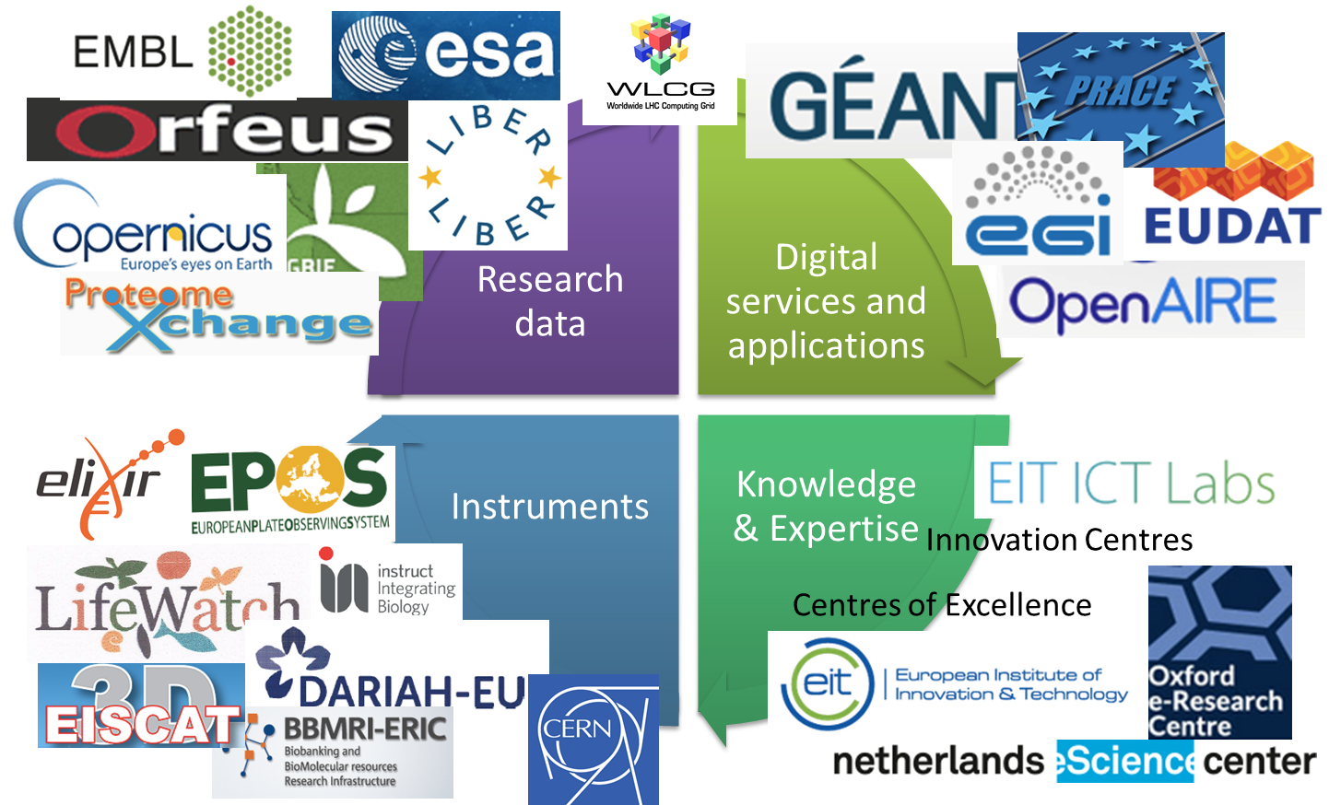
A Common Endeavour (EU Perspective)

Slide 37
OpenAIRE-Connect
Connected to EOSC
Builds on the OpenAIRE infrastructure to adapt it for open science.
Beyond outputs and data; code, images, software, everything digital. “Research artefacts”
Nodes and links between the artefacts to connect them together. Research Packages.

Slide 38
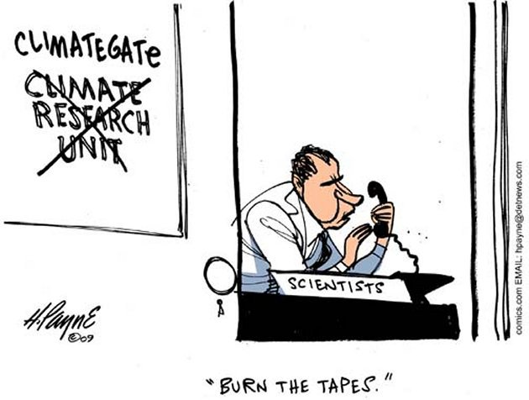
Climategate
Notes:
“We have suggested that the community consider becoming more transparent by publishing raw data and detailed methodologies. “House of Commons Science and Technology Committee
https://www.publications.parliament.uk/pa/cm200910/cmselect/cmsctech/387/387i.pdf

Slide 39
Future innovation

Slide 40
Seven Shifts in Scholarship: Observations on the Future of Research
1. Computational capability
2. Citizen engagement
3. Co-production
4. Interdisciplinary
5. Automation
6. Scholarly Communication
7. Infrastructure
Notes:
Seven Shifts in Scholarship: Observations on the Future of Research
David De Roure, University of Oxford
Introduction
New research methods are being established in and across disciplines, especially as emerging technologies are deployed in innovative ways to address contemporary research challenges. While part of this landscape involves the adoption of new computational techniques enabled by increasingly powerful hardware, as often exemplified by data science, there is also significant democratisation of research as citizens and scholars alike are empowered to interact routinely with the digital world and to engage in co-production.
This short briefing note embraces this broader perspective of the technical and social—citizens and scholars at scale—and identifies seven shifts in scholarship which characterise changing research practice.
1. Computational capability
Technological advances provide growing computational capacity that affords new data processing and simulation capabilities. This promises an acceleration in research, which is immediately attractive to competitive scientific endeavours, but also a capability to address research questions which could not be attempted before. Originally identified as data-intensive science [1], this has come to be exemplified today as data science and big data.
Computational methods are beginning to be used with live data streams to provide real-time analysis, and fusion of live and stored data. As well as high-end computing becoming more powerful and more accessible, our personal devices are increasingly capable of computation and visualisation, putting data science tools into everyday use. With this comes a demand for computational skills (algorithmic, software) to develop new capabilities, and across the widening user base to aid use and interpretation.
Computational techniques continue to be adopted beyond science and engineering, for example computational social science is now established, and computational humanities is emerging. These new domains are demonstrating that it is possible to apply computational techniques to data without having direct access (“non-consumptive research”, first adopted in analyses of full text corpora), and to perform analyses when the data remains encrypted or anonymised.
2. Citizen engagement
Technological advance, often characterised by Moore’s Law, underpins the growing computational capability, but also the increasing availability and adoption of digital devices which have enabled large scale participation of citizen and scholar alike, through the Web and apps. This progress has given us social computing, Science 2.0 and citizen science.
Galaxy Zoo, for example, engaged 165,000 people in the visual characterization of galaxies, and generated scientific discoveries as the citizens interacted through discussion fora and engaged with the science itself. Its successor platform, Zooniverse, has engaged over a million users in projects ranging from nature to the humanities, and today anyone can build a citizen science project. Citizens and computation come together in ClimatePrediction.net, which generates scientific discoveries through people volunteering their computers in the world's largest climate modelling experiment.
Citizen science is becoming mainstream as a research method [2]. Meanwhile citizen engagement at scale is a means of analysis but also supply of data with crowdsourced data collection, while our digital transactions and interactions give rise to the new forms of (personal) data for study. It also enables new methods such as collaborative authoring, collaborative design and crowd funding, which benefit research beyond crowdsourced data collection and analytics.
3. Co-production
We see a changing mode of knowledge production in contemporary research, increasingly recognised by researchers and funders using phrases like ‘living lab’, ‘research in the wild’ and ‘mode 2’. Focused on specific problems and persistent contexts in the real world, it involves in situ design, development and evaluation, with interdisciplinary teams working together in pursuit of applicability (and hence impact) as well as scientific knowledge. While field studies are already familiar in social science, this co-production can extend to citizen-led design and research.
One such example is research set in cities, or ‘urban big data’, which can combine many information sources including sensors, building information management systems, transport, social media and administrative data, as well as personal interactions and transactions. In contrast to data collected in a laboratory, this ‘in the wild’ approach brings far greater complexity in terms of stakeholders, data ownership, permissions for use and re-use, privacy, responsible innovation and ethics.
4. Interdisciplinarity
Academic disciplines have become established over centuries and define areas of expertise. As well as structuring our organisation of knowledge, disciplines have come to delineate organisation, funding, assessment and research cultures. While some new disciplines have emerged in combination (e.g. biochemistry, geophysics, bioinformatics), the overall trend has been increasing specialisation.
In contrast, many research challenges, especially grand challenges which address pressing societal problems, require the development and application of multidisciplinary expertise. While new methods, such as computational methods and data science, may be created within disciplines, they often have broader applicability and hence cut across traditional boundaries. In this way digital methods become a means to work across traditional boundaries and enable interdisciplinary working.
Sharing research data and research methods to tackle multidisciplinary challenges means crossing disciplinary borders. Rather than retrofitting digital scholarship into historical practices and disciplinary divisions, there is a need to learn from past practice and look ahead to new paradigms. Data science initiatives today illustrate one means of challenging these boundaries, and are leading to new skills development which transcends traditional curricula established within individual domains.
While this hints at a post-disciplinary future, we see different disciplines coming upon a ‘computational turn’ at different times, and creating new (sub)disciplines on the way; the challenges of boundaries could get worse before they get better. 5. Automation
The increasing scale of data processing and analytics has brought with it increasing automation, as researchers turn to computers to provide assistance through the software tools and services they deploy. This extends to routine processing without the ‘human in the loop’, especially in fields where data is arriving in live streams. In addition to batch processing in order to scale up, we are seeing increasing adoption of AI techniques, so that computers can conduct stages of research automatically.
This transition from scaling up towards adoption of machine learning is also evident in crowd engagement. While citizen science is also a response to growing tasks of data reduction, the impressive scaling effect of crowdsourcing is only a temporary solution for complete processing: as scale continues to increase, the work of the crowd is set instead to inform the growing automation of data analytics.
Data supply is only set to increase, be it through new experimental equipment or the sensors of the Internet of Things, and with this will come increasing automation. While benefits are apparent, this also raises important questions about the role of the human (what is the research equivalent of the driverless car?), about the influence of algorithms, about explanation, and about reproducibility.
Some recent research innovations may act as a rehearsal in new methods, for example several fields have embraced social media analytics and are beginning to work in ‘near real-time’. These also illustrate the challenges as systems become both automated and adaptive, including echo chamber effects and issues of ethical algorithms.
6. Scholarly Communication
Given these shifts in scholarly practice, the question might reasonably be asked: is our model of scholarly communication still fit for purpose? It has certainly been robust in the face of change: while the web was invented at CERN to enhance science communication and has enabled transformation in so many ways, scientific publication still looks remarkably as it did in years past.
The issues with our scholarly communications ecosystem are widely examined and reported. We are seeing principles identified, and steps taken to address the problems of disclosing and sharing research information [3]. The goal of these interventions is to support innovative and productive research. One such initiative is FORCE11 (Future of Research Communications and e-Scholarship), which published data citation principles in 2012 [4]; it has recently published software citation principles [5], which is a significant step in acknowledging software as a first class citizen in the scholarly ecosystem. Libraries and publishers engage closely in these discussions, as they respond to disintermediation and re-identify their roles (e.g. curation, discovery) in the changing landscape.
Reproducible research is also receiving much attention [6] and needs to be considered in the light of the shifts summarised here, such as automation, real-time data supply, and machine learning. The underlying challenge is to move from our established paradigm of articles and books, which may be seen as static products, to a future where knowledge is co-produced, abundant and perpetually in flux.
7. Infrastructure
Research infrastructure describes the shared capabilities that persist beyond individuals and projects. It encompasses technical infrastructure but also research content and human capacity. This may be referred to as e-Infrastructure, though this often majors on technical capability and service provision; for example the e-Infrastructure Reflection Group defines the e-Infrastructure commons as “networking, computing, storage, data and software, along with digital tools and collaboration opportunities” [7]. Unlike physical infrastructure, our digital infrastructure collocates people virtually.
One aspect of infrastructure that is little discussed but increasingly important is cybersecurity. Trust and resilience are key requirements of the research infrastructure. As the systems which develop our research are increasing in scale and complexity, and are increasingly coupled and automated, we are prone to (a) an increasing rate of accidental failures and unanticipated emergent behaviours, and (b) increasing vulnerability to abuse and attack, with cascading effects.
In discussing the future of research it is perhaps helpful to take the broader perspective of knowledge infrastructure: “robust networks of people, artefacts, and institutions that generate, share, and maintain specific knowledge about the human and natural worlds.” [8] This encompasses individuals and organisations (such as libraries), but also routines, shared norms and practices, and it enables a broader discussion as to how infrastructures reinforce or redistribute authority, influence and power.
References
[1] T. Hey, S. Tansley, and K. Tolle (Eds)., The Fourth Paradigm: Data-Intensive Scientific Discovery, Redmond, VA: Microsoft Research, 2009, ISBN 978-0-9825442-0-4, http://fourthparadigm.org. 2009.
[2] Citizen Science at Universities: Trends, guidelines and recommendations. LERU ADVICE PAPER no.20 - October 2016. http://www.leru.org/files/publications/LERU_AP20_citizen_science.pdf
[3] Boulton G, Campbell P, Collins B, Elias P, Hall W, Laurie G, et al. Science as an Open Enterprise. London: The Royal Society; 2012. https://royalsociety.org/topics-policy/projects/science-public-enterprise/report/
[4] Data Citation Synthesis Group: Joint Declaration of Data Citation Principles. Martone M. (ed.) San Diego CA: FORCE11; 2014. https://www.force11.org/group/joint-declaration-data-citation-principles-final
[5] Smith AM, Katz DS, Niemeyer KE, FORCE11 Software Citation Working Group.
(2016) Software Citation Principles. PeerJ Computer Science 2:e86. DOI: 10.7717/peerj-cs.86
[6] L. C. Burgess, D. Crotty, D. de Roure, J. Gibbons, C. Goble, P. Missier, R. Mortier, T. E. Nichols, and R. O’Beirne, “Alan Turing Institute symposium on reproducibility for data- intensive research – final report”, Alan Turing Institute, 2016. https://osf.io/wjk32/
[7] e-IRG Roadmap 2016 (draft), September 2016. ISBN 978-90-823661-1-2 http://e-irg.eu/documents/10920/12353/Roadmap+2016.pdf
[8] Edwards, P. N., Jackson, S. J., Chalmers, M. K., Bowker, G. C., Borgman, C. L., Ribes, D., Burton, M., & Calvert, S. (2013) Knowledge Infrastructures: Intellectual Frameworks and Research Challenges. Ann Arbor: Deep Blue. http://hdl.handle.net/2027.42/97552

Slide 41
‘Machine readable scholarly record’ ‘Machine readable scholarly record’ ‘Machine readable scholarly record’
Text and data mining. Machine learning, AI, natural language processing, blockchain.
‘Re-useable’ – making the ingredients of research openly available in such a way that experiments can be repeated, reproduced and altered.
Code; input data; systems; software; methods, etc.
‘Defining the Scholarly Record for Computational Research’ CNI spring 2016. Victoria Stodden, Library and Information Science at the University of Illinois at Urbana-Champaign https://www.cni.org/events/membership-meetings/past-meetings/spring-2016/plenary-sessions-s16

Slide 42
Innovative Metrics and Indicators
Current metrics (Impact Factor) widely considered flawed.
The Metric Tide: Report of the Independent Review of the Role of Metrics in Research Assessment and Management: 2015.
Could we, the research community, develop new metrics and indicators openly, based on open methods/formula, using open data, open software/platforms etc?
Jisc Open Metrics Lab

Slide 43
Innovative research outputs
Journals/publishers: open library of humanities; e-life; Journal of research objects; Research Ideas and Outcomes journal; jove.
Beyond the PDF (Force11).
Future of the book/monograph/long-form: ‘Academic book of the future’. Mellon: Monograph Publishing in the Digital Age.

Slide 44
Innovative research centres and skills
Alan turning centre:
“Data science will change the world. We are pioneers; training the next generation of data science leaders, shaping the public conversation, and pushing the boundaries of this new science for the public good.”
The Alan Turing Institute is the national institute for data science, headquartered at the British Library.
Five founding universities – Cambridge, Edinburgh, Oxford, UCL and Warwick – and the UK Engineering and Physical Sciences Research Council created The Alan Turing Institute in 2015 in order to answer a national need for investment in data science research.

Slide 45
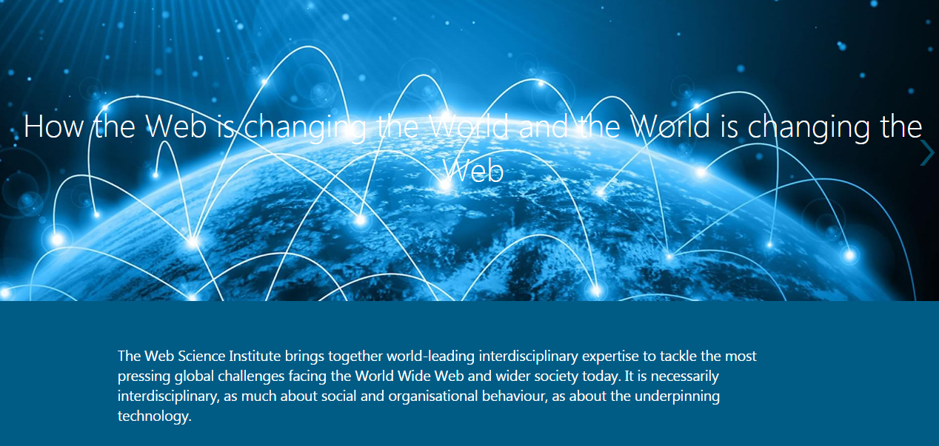
Web science institute : southampton

Slide 46
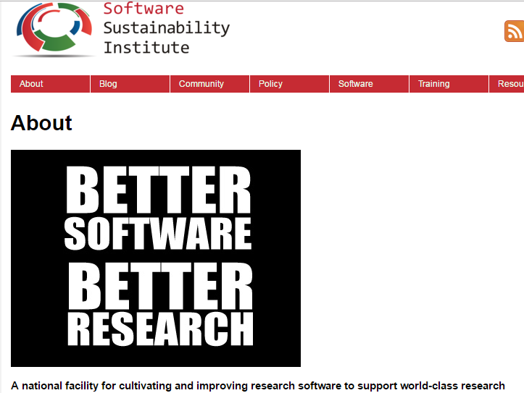

Slide 47
SSI
Better science through superior software
Our work is focussed around four themes we believe are fundamental to doing research correctly in the digital age. These are related to our manifesto.
The first of these is Skills and Training: creating a capable research software community by enabling access to software development training for all researchers and teaching them methods to advance their research.
Recognition and Reward promotes and contributes to systems of credit for good software development and reuse practice.
Career Paths recognises and champions the varied job roles associated with research software; with a primary focus on the academic sector but suggesting industrial practice where applicable.
Finally, Reproducible Research promotes the fundamental place of software in supporting confidence in the research process and its results.
Source: https://www.software.ac.uk/about

Slide 48
Data carpentry & library carpentry

Slide 49
To conclude
Open Access -> Open Data -> Open Science
Open Access: questions about green and gold and sustainability, who pays.
Open Data is starting to become widely adopted, partly due to policy and mandates
Jisc and others provide services in the UK to support Open access/data/science
Open Science is gaining momentum; EU projects to support
Re-using the artefacts/components of research will be a key theme in the future.

Slide 50
Chris Keene
Library and scholarly futures
Chris.Keene@jisc.ac.uk

