Slide 1
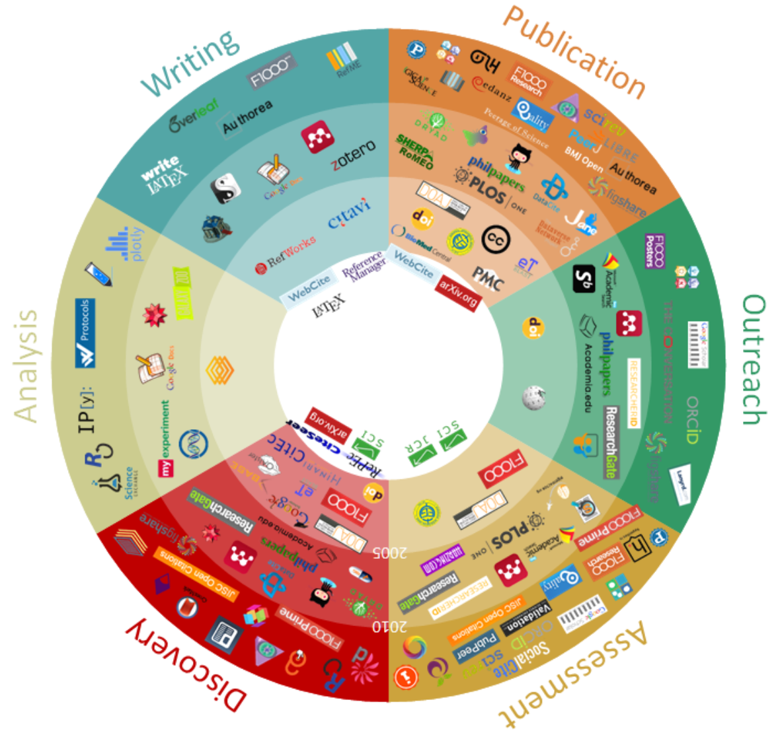
https://101innovations.wordpress.com/
CARIST 2017, 21 mars, Nancy, david.aymonin@abes.fr

Slide 2
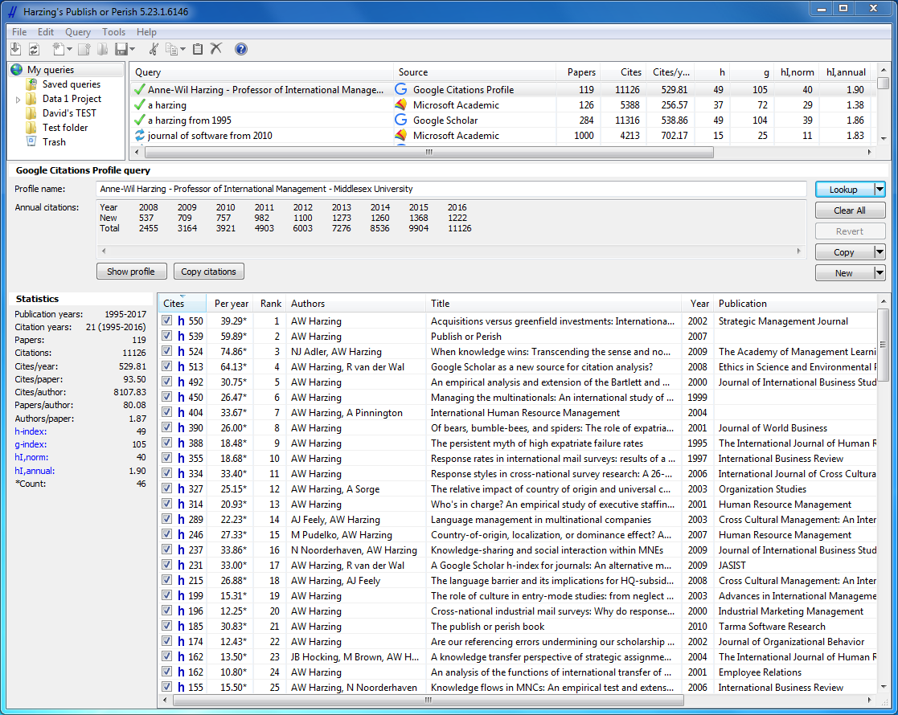
Tous documentalistes
CARIST 2017, 21 mars, Nancy, david.aymonin@abes.fr

Slide 3
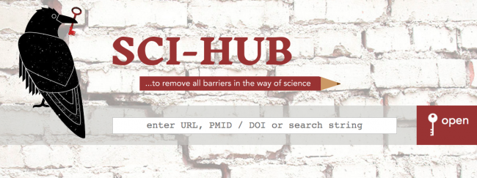
Entrez c’est ouvert
CARIST 2017, 21 mars, Nancy, david.aymonin@abes.fr

Slide 4
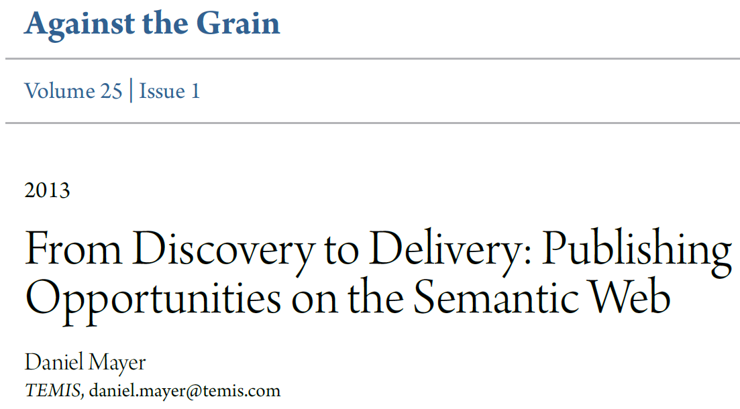
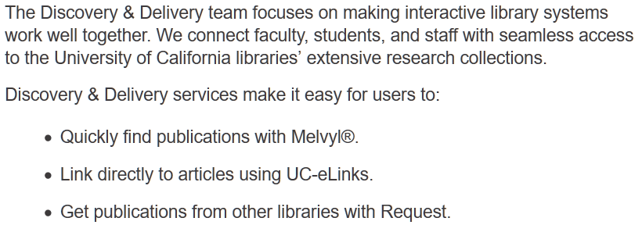
From Discovery to Delivery – Concepts
CARIST 2017, 21 mars, Nancy, david.aymonin@abes.fr

Slide 5
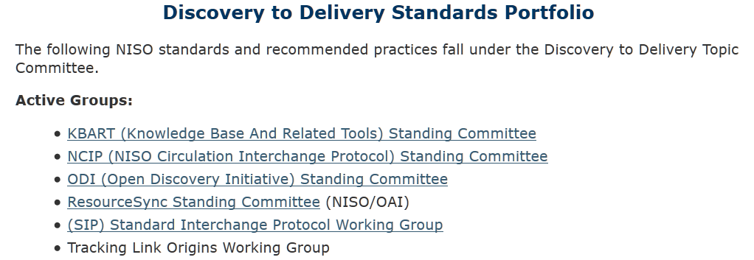
From Discovery to Delivery - Normes
CARIST 2017, 21 mars, Nancy, david.aymonin@abes.fr

Slide 6
L’enjeu pour les professionnels de l’IST
Structurer
Exposer
Enrichir
Aligner
CARIST 2017, 21 mars, Nancy, david.aymonin@abes.fr

